Slide 1
进展汇报
2021.9.29

Slide 2
本周进展
撰写毕业论文。
阅读一篇VR+EEG评估心理压力的论文。

Slide 3
Workplace Mental State Monitoring during VR-Based Training for Offshore Environment
Sensors 2021
中科院SCI工程技术2区

Slide 4
Introduction
1. Prolonged stressful conditions can lead to physical and mental health deterioration.
2. The electroencephalography (EEG) is the most used brain-monitoring method for mental stress.
3. However, monitoring the EEG signals in an actual workplace can disrupt the working routines.
4. Although VR has been used with the EEG for meditation therapy purposes, it has not been used as an integrated system to monitor mental health in workplaces.

Slide 5
Introduction
5. Leading oil and gas companies have adopted the VR technology in their training and operations.
6. In this paper, we evaluate three different mental states induced when performing a stressful task within a VR offshore environment.

Slide 6
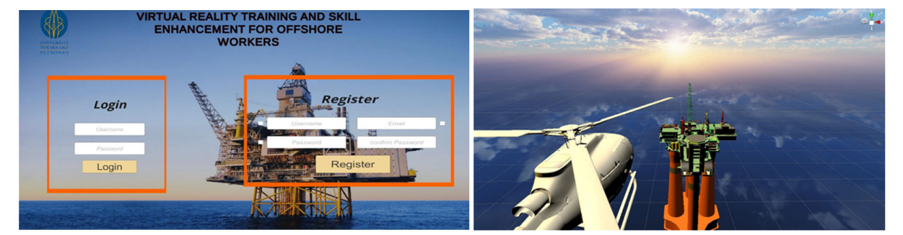
VR-Based Training Environment
1. Software and hardware: Unity3D, HTC Vive.

Slide 7
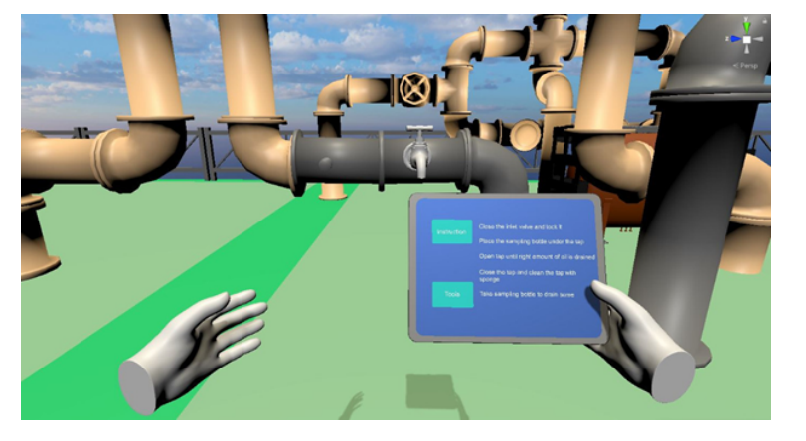
VR-Based Training Environment
2. Module 1: Oil Sampling
(1) Close the inlet valve.
(2) Lock the tank.
(3) Place a sampling bottle under the tap.
(4) Open tap.
(5) Close tap and clean.

Slide 8
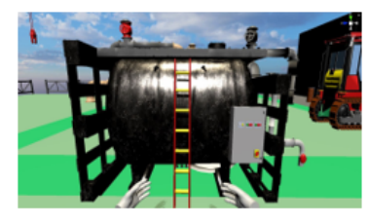
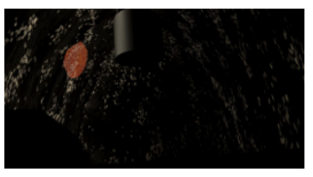
VR-Based Training Environment
3. Module 2: Confined Space Inspection
(1) Close the inlet valve.
(2) Switched off sensor power.
(3) Touch the ladder.
(4) Climb to the top of tank.
(5) Enter the tank.

Slide 9
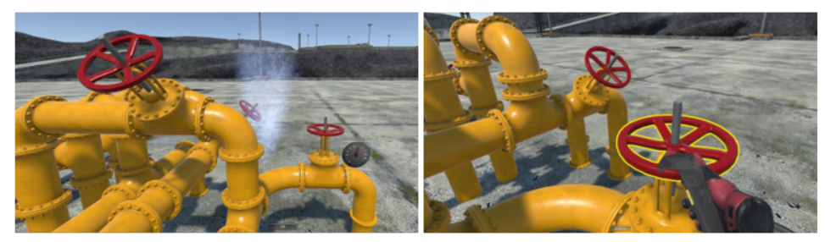
VR-Based Training Environment
4. Module 3: Pipeline Valve Rotation
(1) Rotate the valve in clockwise direction for at least 30 turns using the controller.

Slide 10
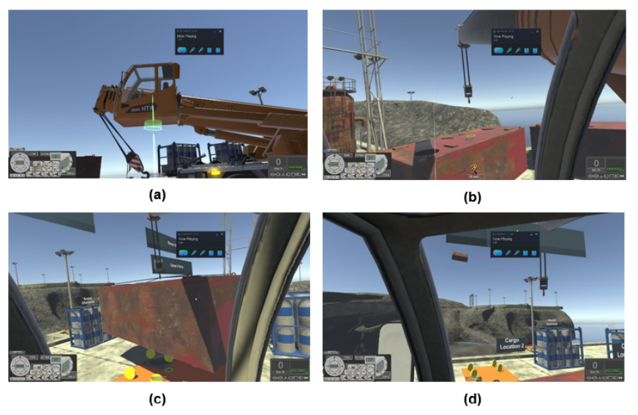
VR-Based Training Environment
5. Module 4: Crane Training
(1) Moving large cabins without any collision.

Slide 11
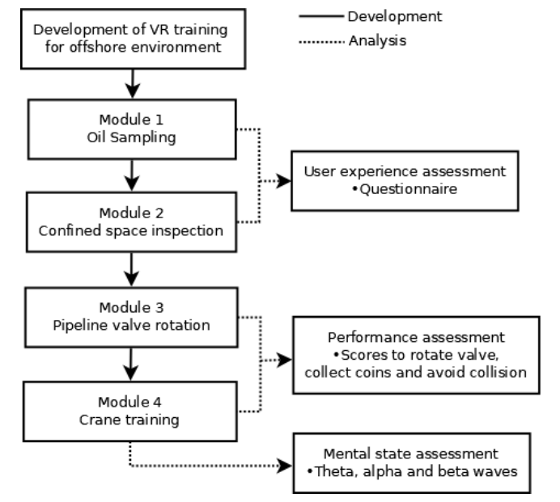
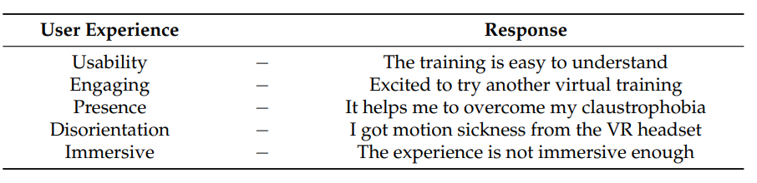
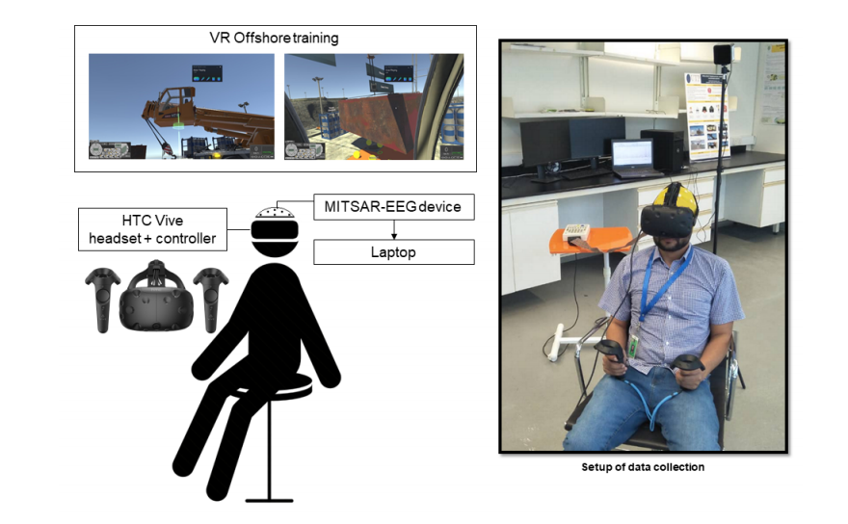
Mental State Monitoring during VR Training
1. 21 healthy participants, aged 18 or above.

Slide 12
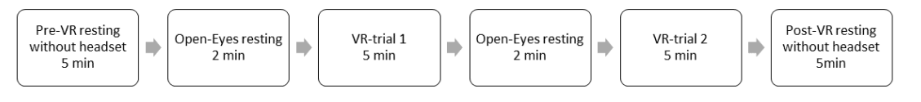
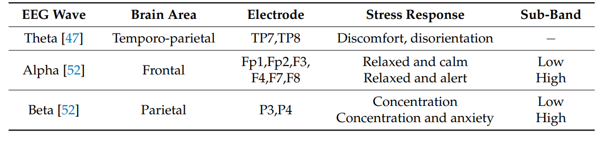
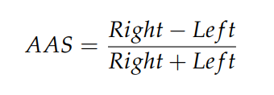
Mental State Monitoring during VR Training
2. Mental state assessment using EEG
(1) 32 channels, 500 Hz.
(2) Record:
(3) EEG Analysis: EEGLAB (band pass filter, ICA, 30s epochs)

Slide 13
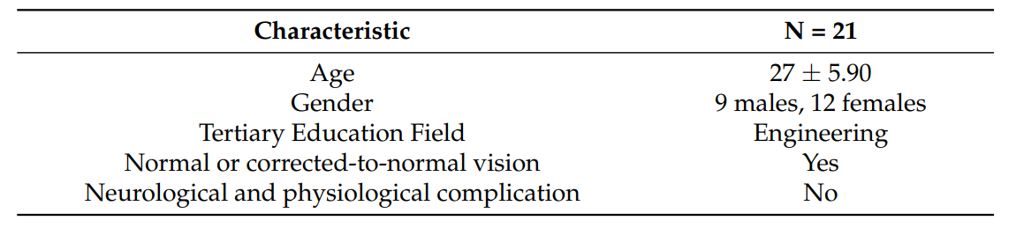
Results
1. Characteristics of participants

Slide 14
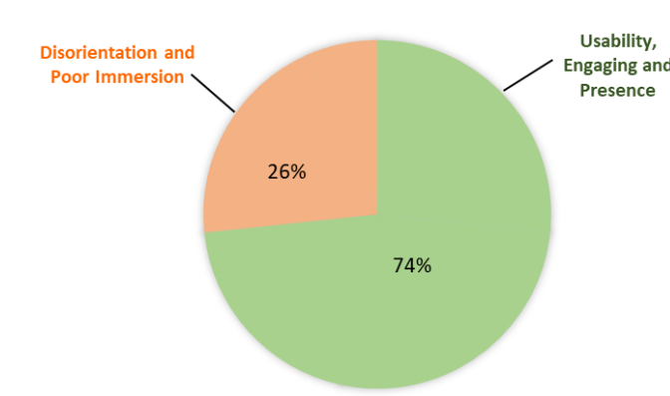
Results
2. User experience assessment: 74% gave positive responses on their VR experience with regards to the usability, engagement and sense of presence.

Slide 15
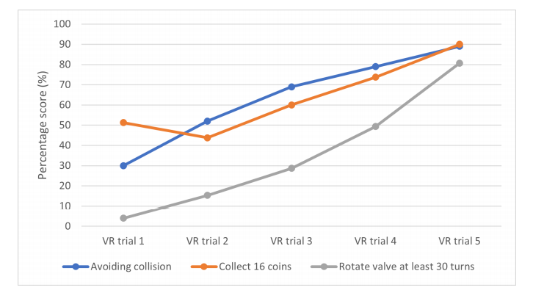
Results
3. Performance Assessment: As more training were given to the participants, they were able to finish task with more ease.

Slide 16
Results
4. EEG
(1) Theta/Alpha: decrease during VR trails.
(2) Beta: increase during VR trails.
(3) The AAS is associated with the strategies taken to cope with stress, with negative asymmetry reflect withdrawal strategies and positive asymmetry for approach strategies.

Slide 17
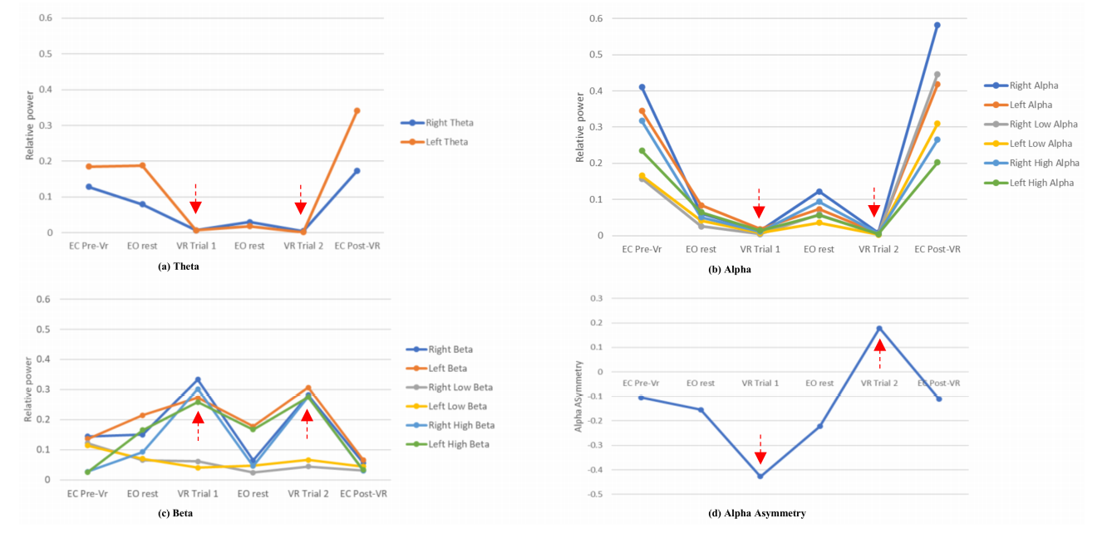

Slide 18
Discussion
1. With the increase level of realism in a stressful VR environment, precaution must be taken to ensure extreme stress is not induced during the VR experience.
2. Change in the alpha activity from high to low indicates increasing alertness and attention to external stimuli, as observed during the VR trial.
3. In our study, the decrease level of relative theta power observed between the VR trials suggest disorientation and discomfort when wearing the VR headset.

Slide 19
Conclusions
1. In conclusion, this study shows that the changes in mental states due to discomfort, stress and concentration induced when performing VR tasks.
2. In settings where the workers are under risk conditions or involved in complex routines, the use of EEG in identifying potential stressors (压力源) can ensure the development of safer and effective VR environments.

Slide 20
下周计划
写毕业论文。
阅读一篇论文。

